Slide 1
Cloud CPRS Experience
Kathleen Kendle, MD FACP
Valley Coastal Bend VAMC

Slide 2
Cloud computing
On demand availability of computer system resources
Data storage
Computing power
Data Centers available to many users over the Internet
Cloud may be limited to a single organization---enterprise clouds
Cloud computing relies on sharing of resources to achieve coherence and economies of scale
Cloud computing allows companies to avoid or minimize up front IT infrastructure costs
Burst computing---high computing power at certain periods of peak demand
Pay-as-you-go model
Device and location independence
Enables users to access systems using a web browser regardless of their location or what device they use (PC, mobile phone etc…). As infrastructure is off site and access via internet, users can connect from anywhere
Maintenence

Slide 3
Cloud CpRS
VCB experiences with CPRS in the cloud
Performance
Reliability
Other benefits
Impact on Clinicians and Patient experience
Cloud CPRS and other tools
How else could cloud help you and VCB
How can ECSO help clinicians in the field

Slide 4
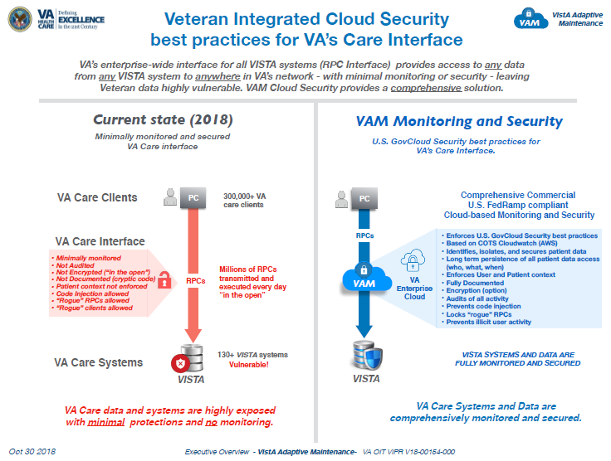
Cloud CpRS

Slide 5
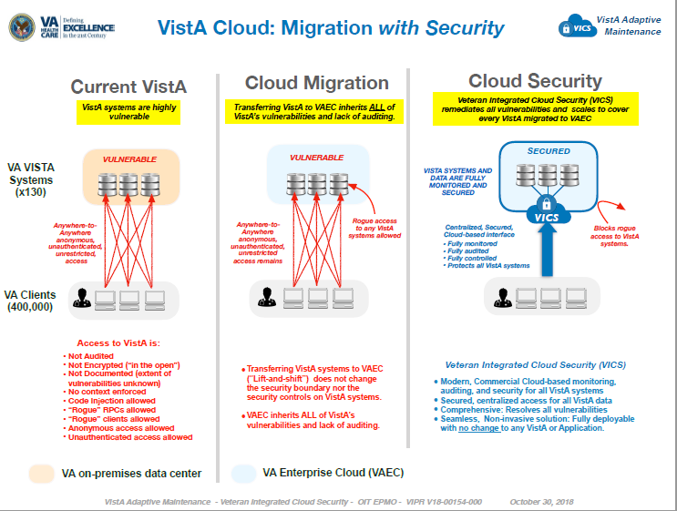
Cloud CpRS

Slide 6
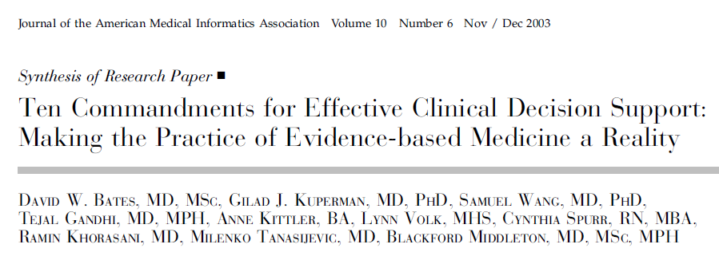
Cloud CpRS

Slide 7
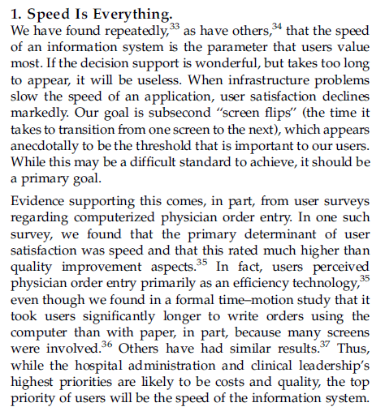
Cloud CpRS

Slide 8
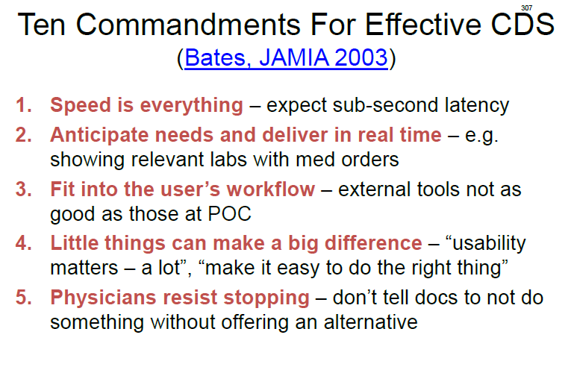
Cloud CpRS

Slide 9
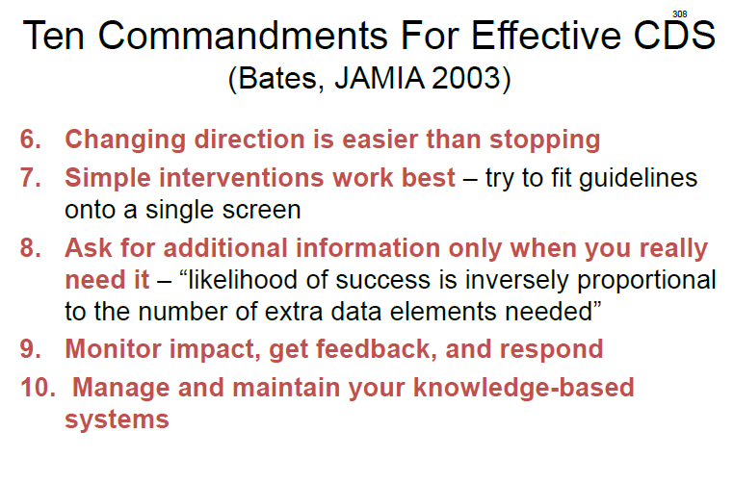
Cloud CpRS

Slide 10
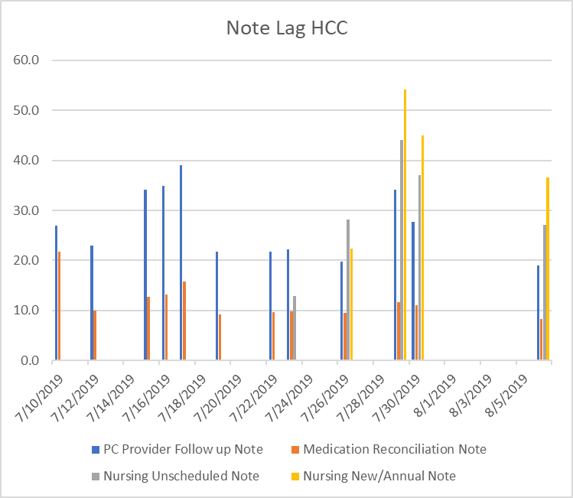
Cloud CpRS
Average: 27s

Slide 11
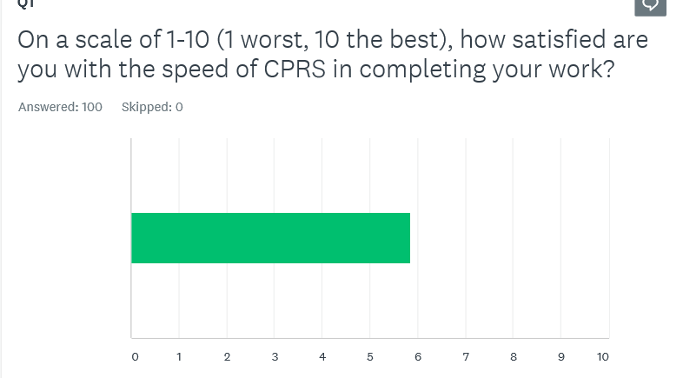
Cloud CpRS

Slide 12
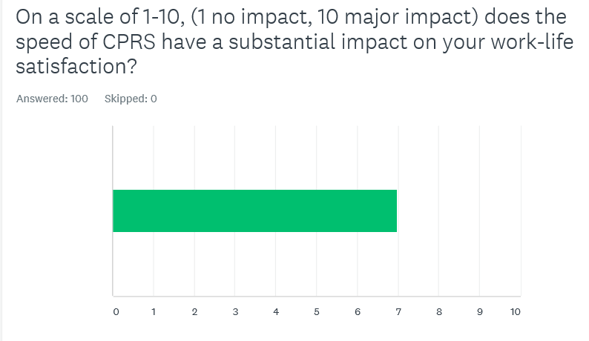
Cloud CpRS

Slide 13
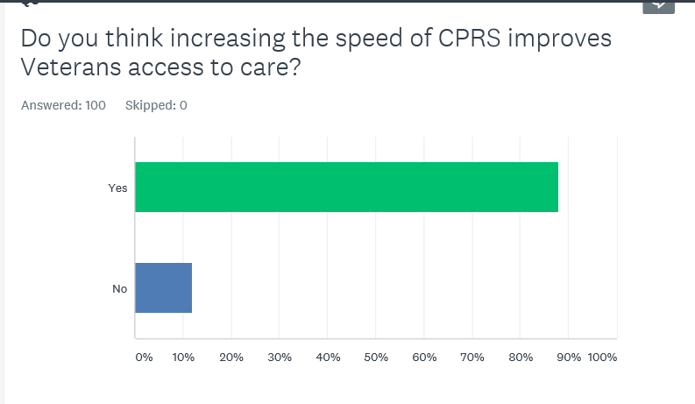
Cloud CpRS

Slide 14
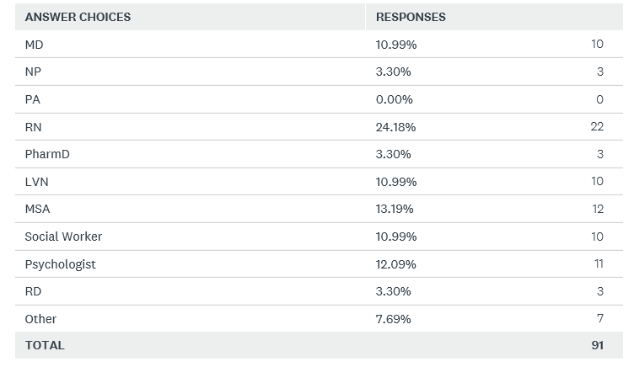
Cloud CpRS

Slide 15
CPRS: note rendering speed
From 27s to 2s!!

Slide 16
Note rendering lag translates to the equivalent of these losses to clinical productivity

